Slide 1
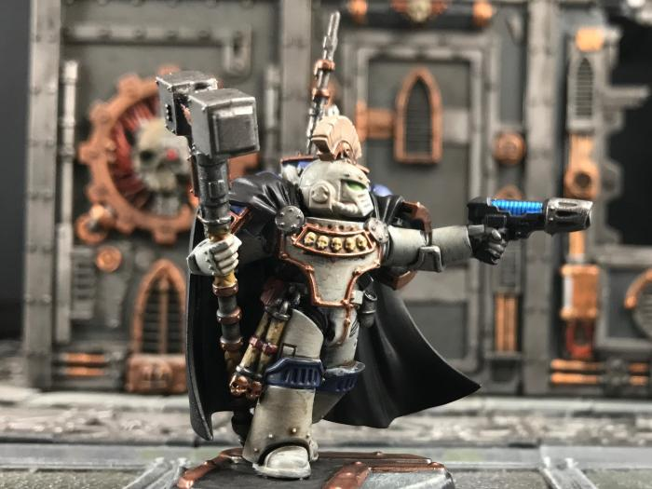
Praetor ()

Slide 2
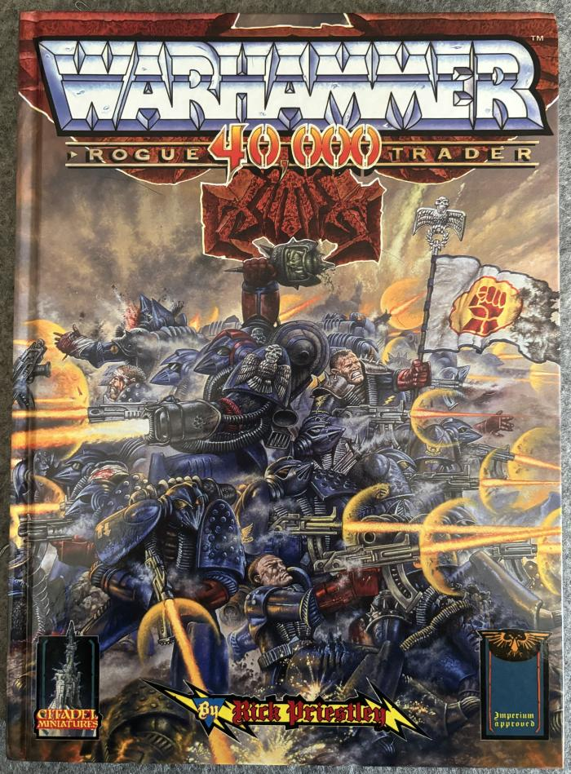
Warhammer 40,000 Rogue Trader ()

Slide 3
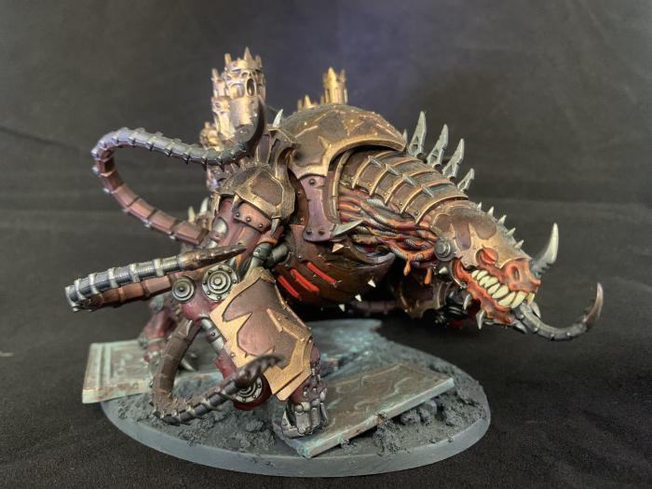
Mauler fiend ()

Slide 4
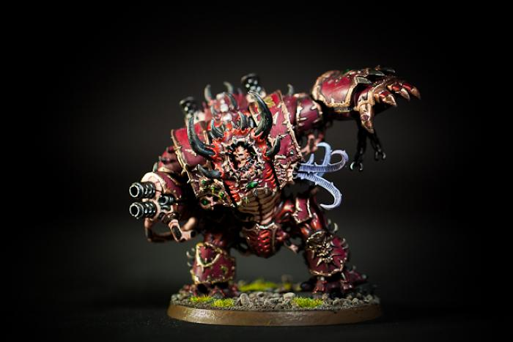
Helbrute ()

Slide 5
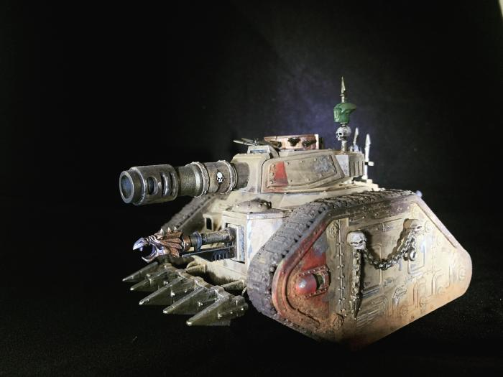
Leman Russ Battle Tank ()

Slide 6
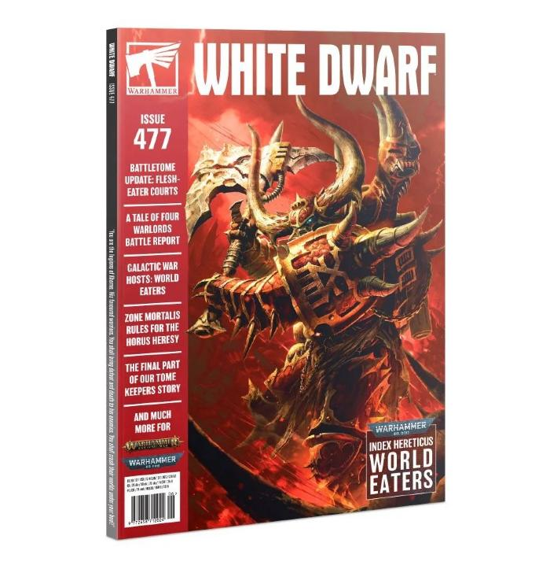
White Dwarf Issue 477 ()

Slide 7
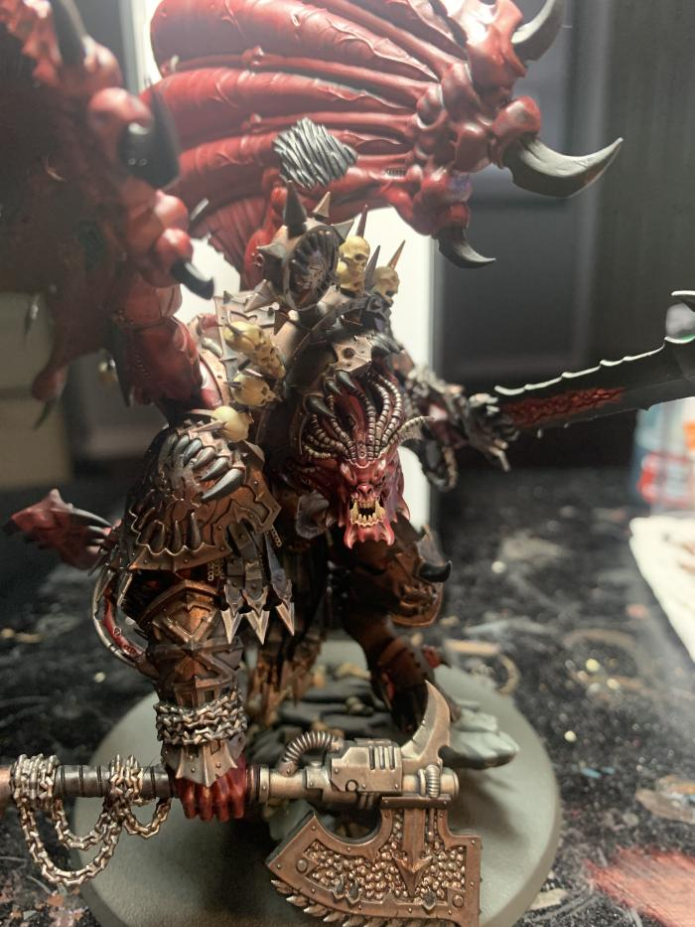
Angron, Daemon Primarch of Khorne ()

Slide 8
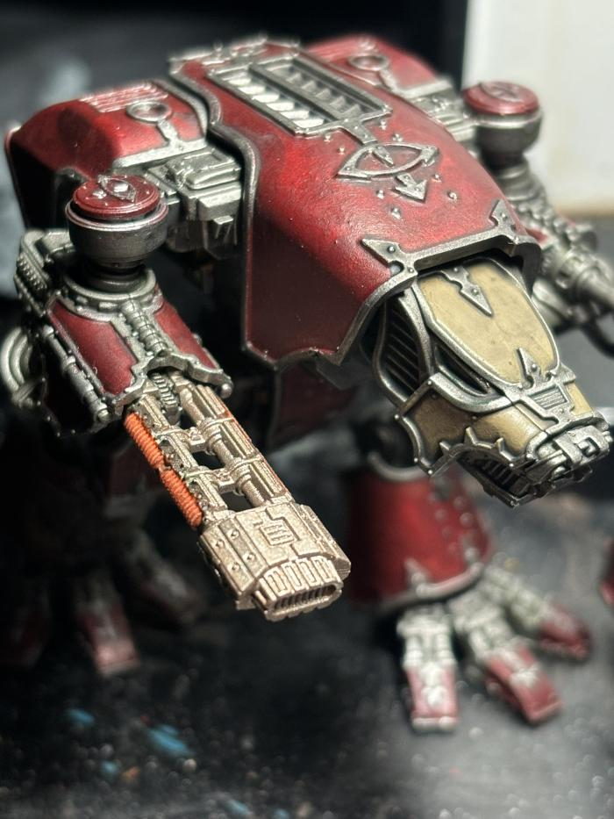
Warhound Titan ()

Slide 9
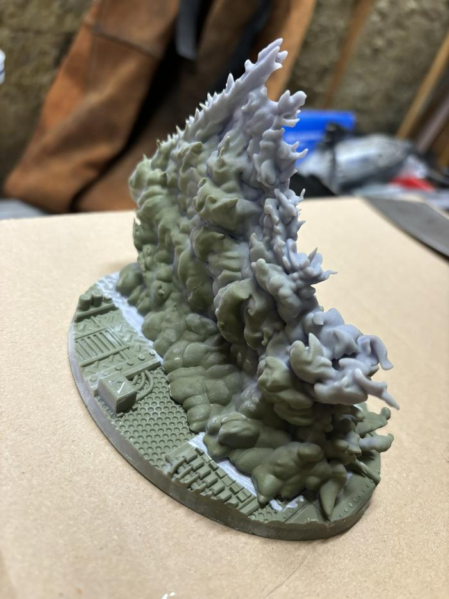
Heldrake ()

Slide 10
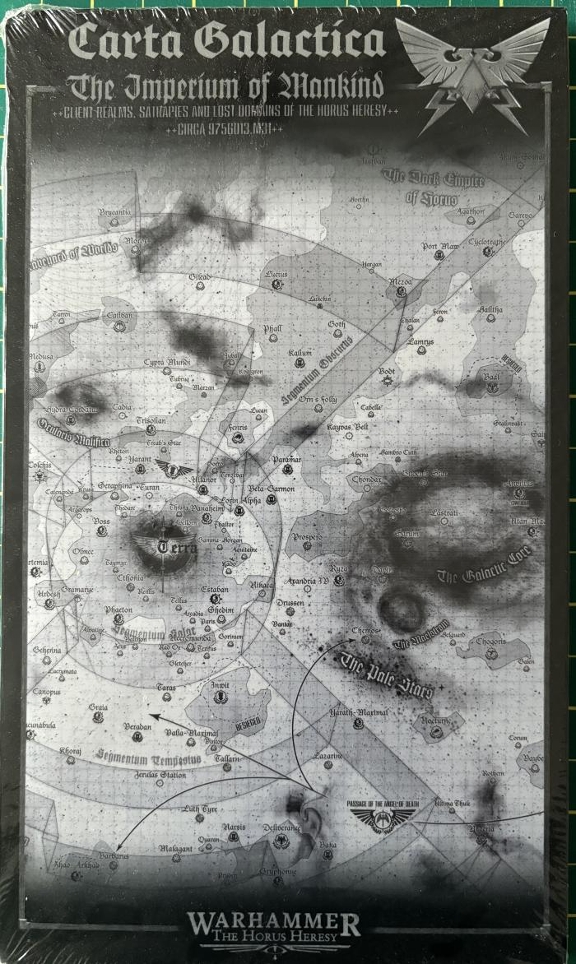
Legions Imperialis: Carta Galactica – The Imperium of Mankind ()

Slide 11
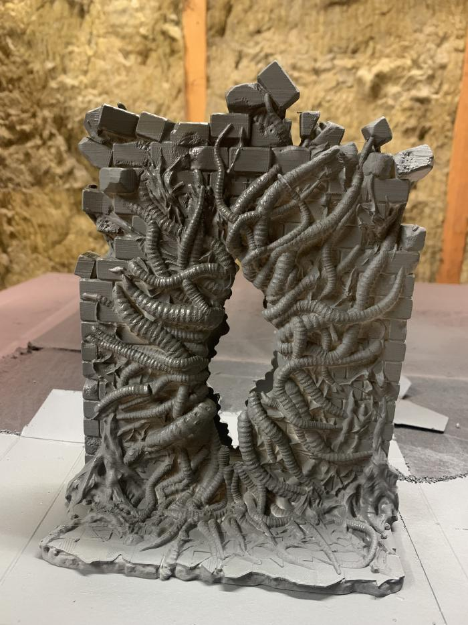
Calling Portals - Failed Experiment ()

Slide 12
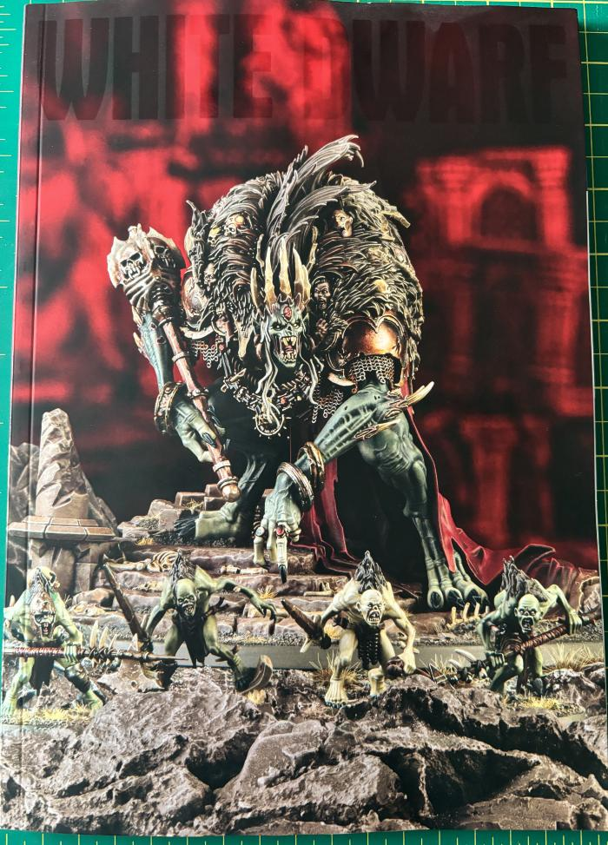
White Dwarf Issue 497 ()

Slide 13
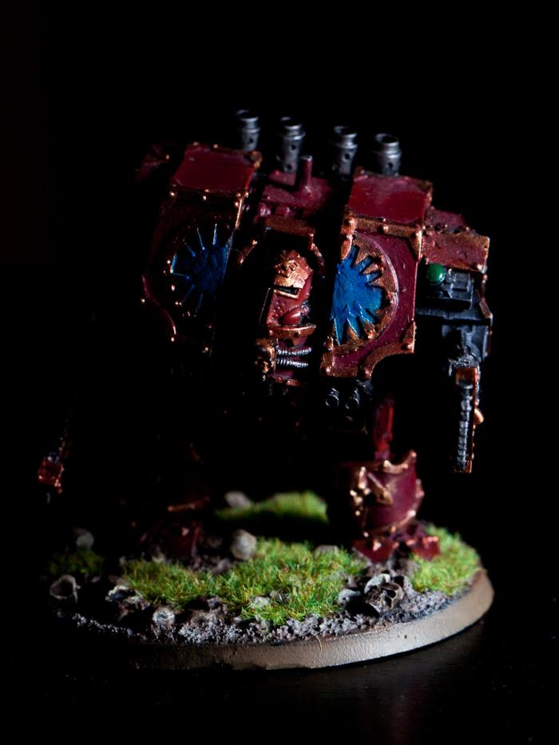
Helbrute ()

Slide 14
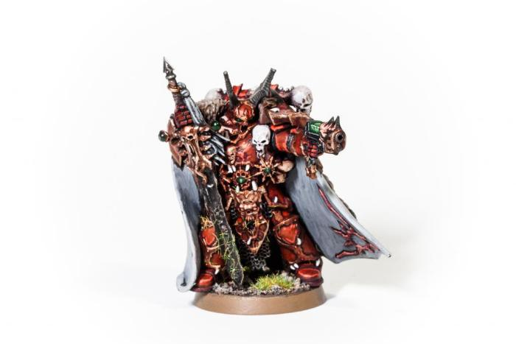
Kranon the Relentless, Chaos Lord ()

Slide 15
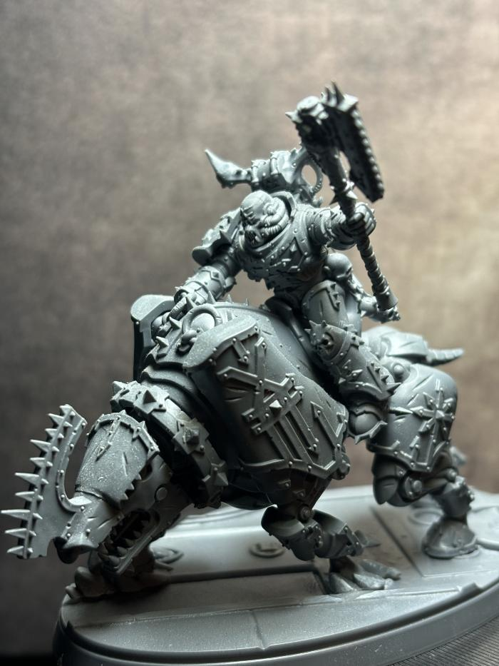
World Eaters Lord on Juggernaught ()

Slide 16
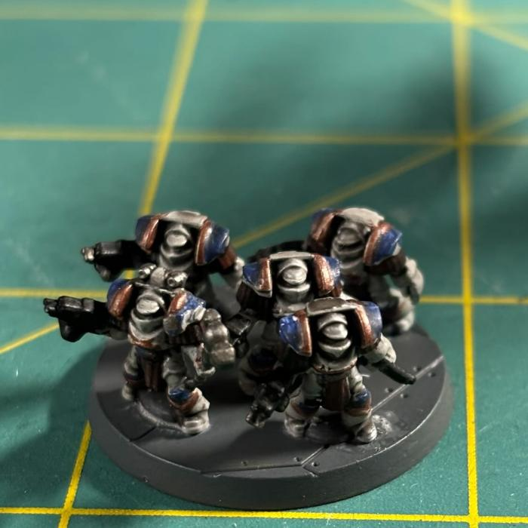
Legion Terminator Squad ()

Slide 17
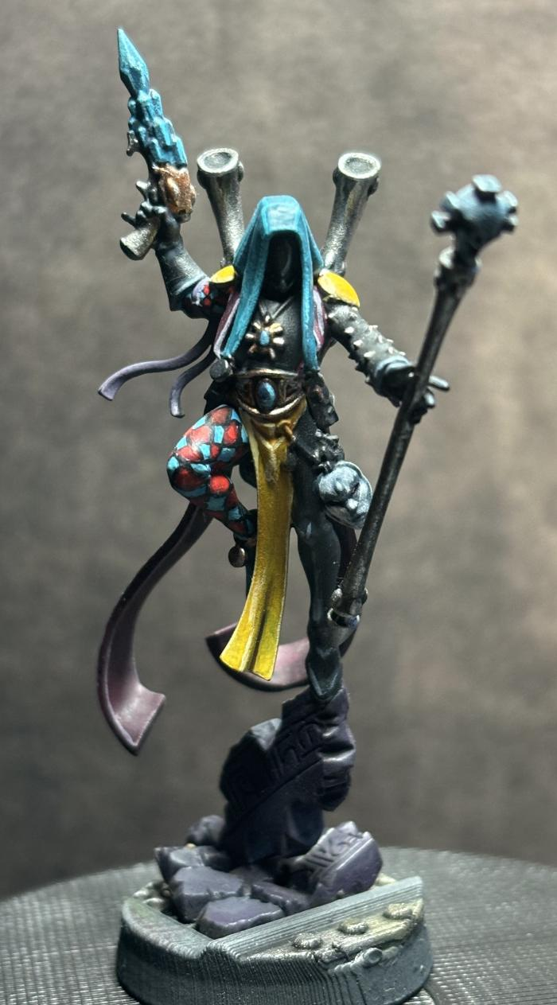
Shadowseer (189)

Slide 18
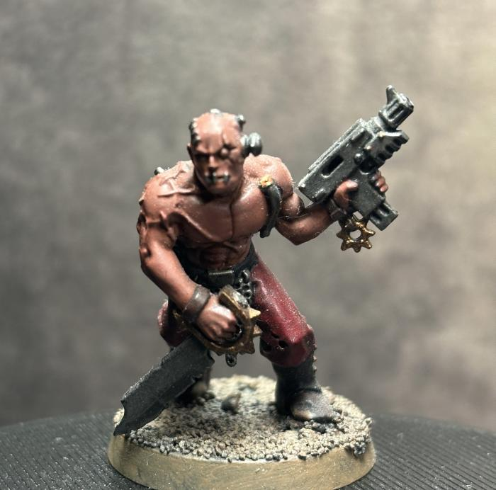
Chaos Cultist (199)

Slide 19
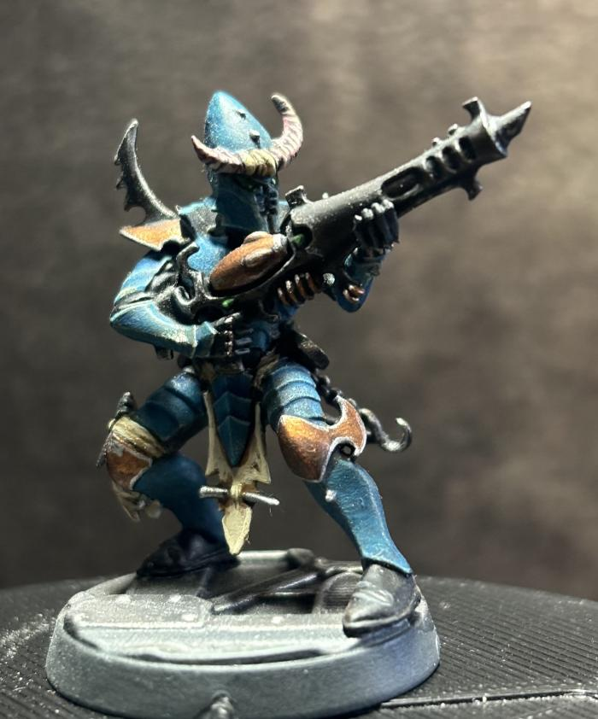
Kabalite Warrior (226)

Slide 20
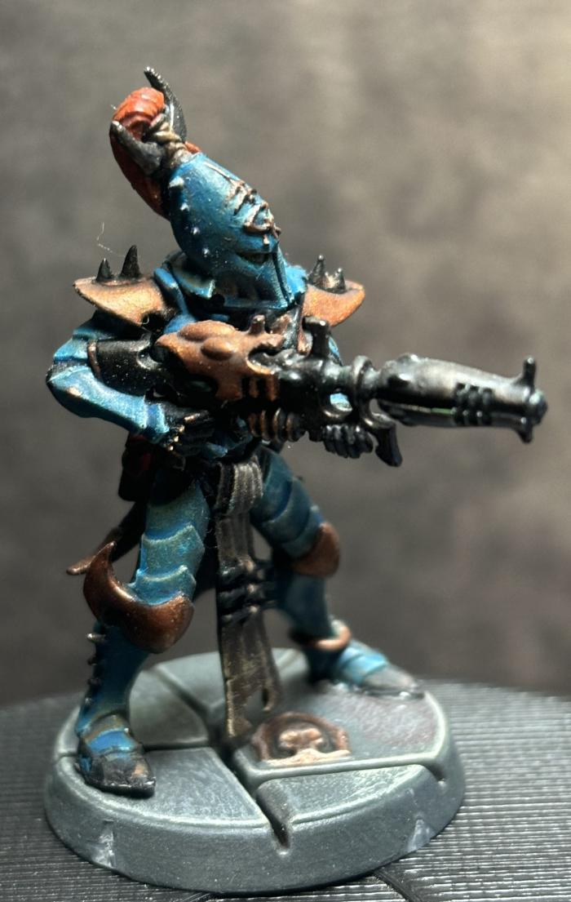
Kabalite Warrior (230)

Slide 21
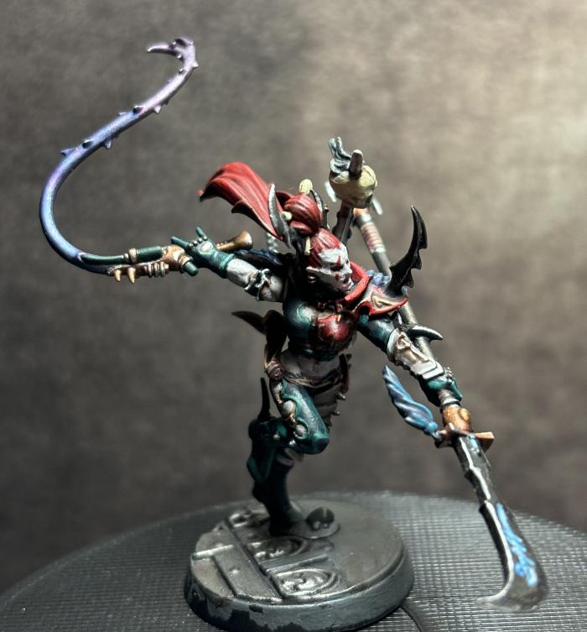
Succubus (236)

Slide 22
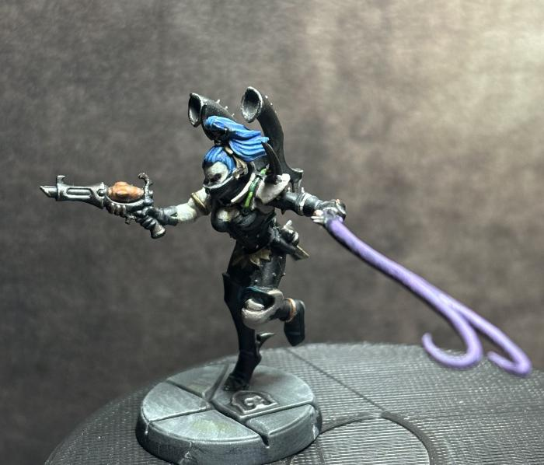
Hekatrix (240)

Slide 23
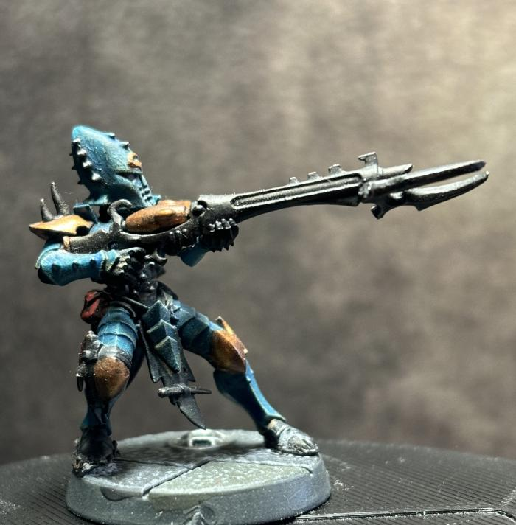
Kabalite Warrior (246)

Slide 24
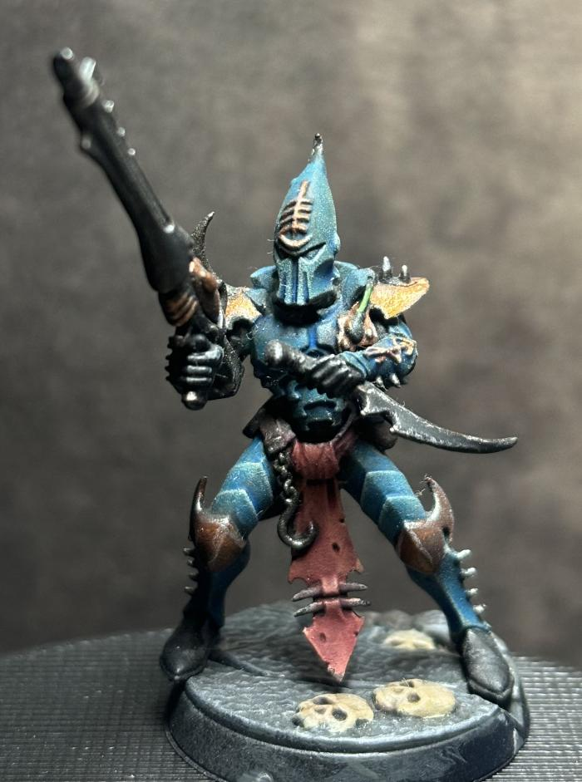
Kabalite Warrior (247)

Slide 25
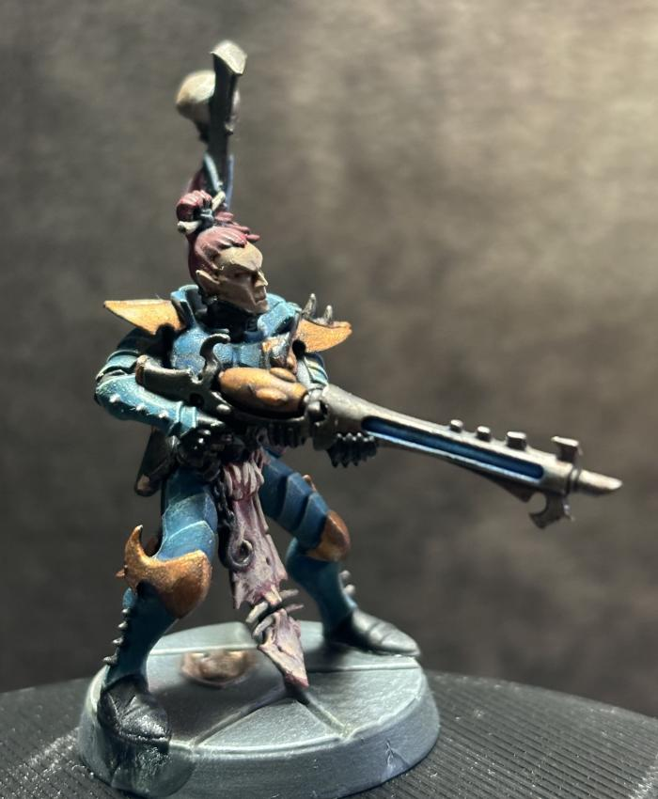
Kabalite Warrior (248)

Slide 26
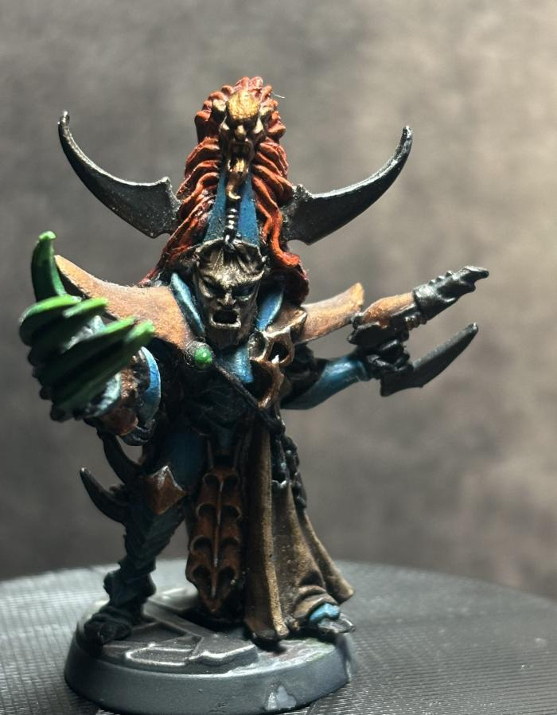
Archon (249)

Slide 27
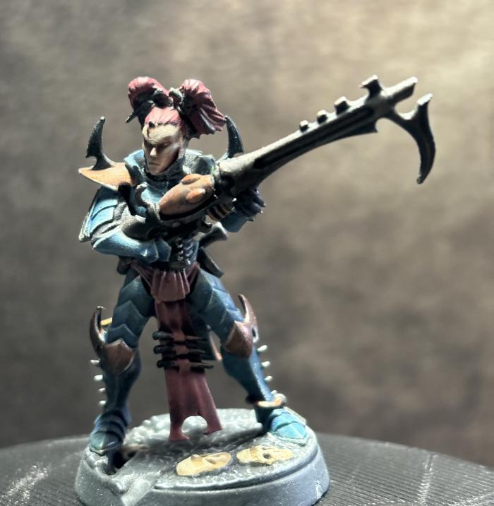
Kabalite Warrior (250)

Slide 28
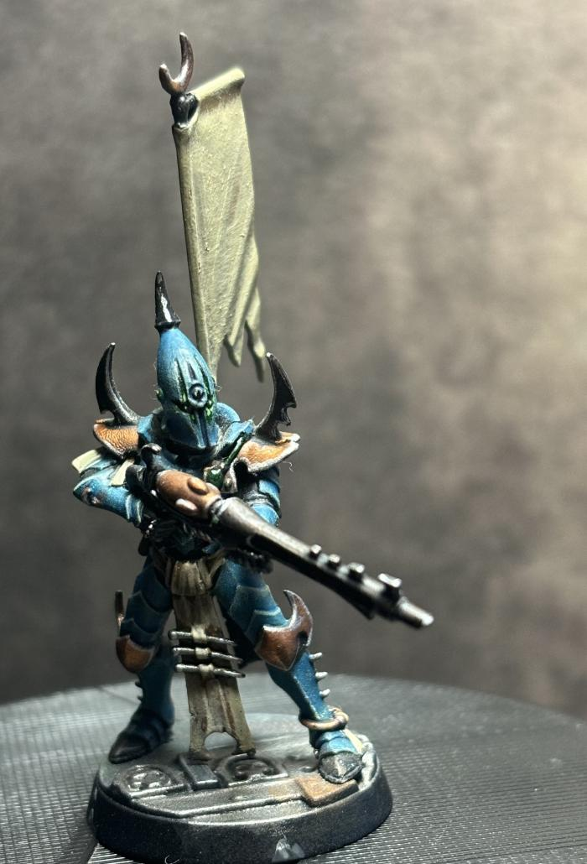
Sybarite (252)

Slide 29
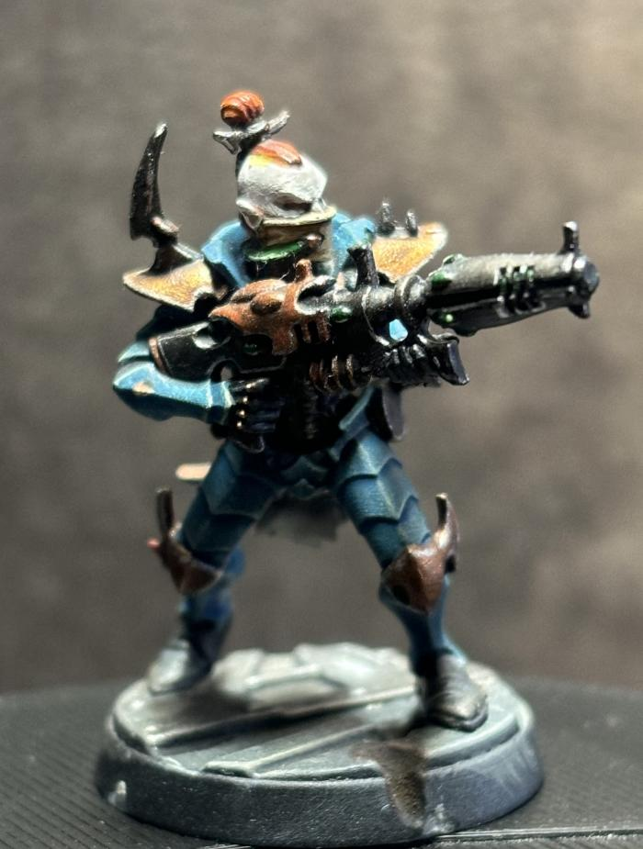
Kabalite Warrior (255)

Slide 30
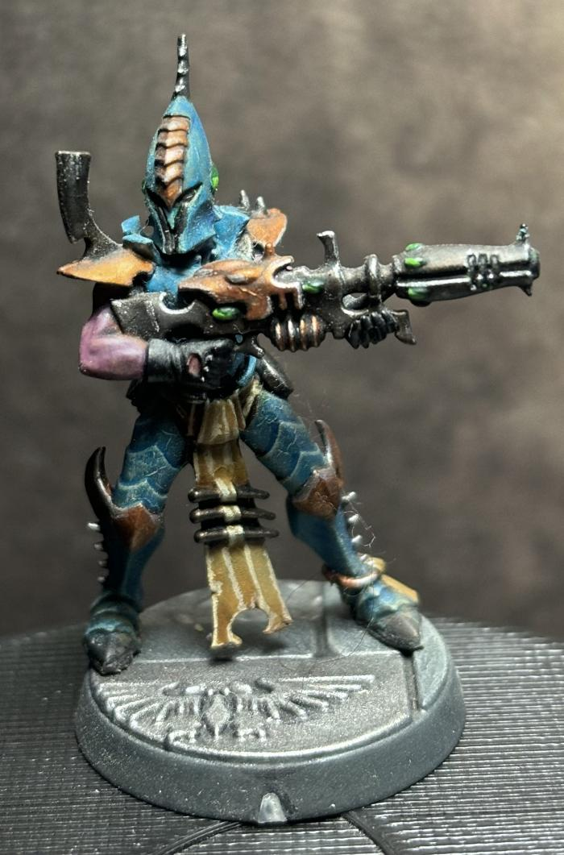
Kabalite Warrior (257)

Slide 31
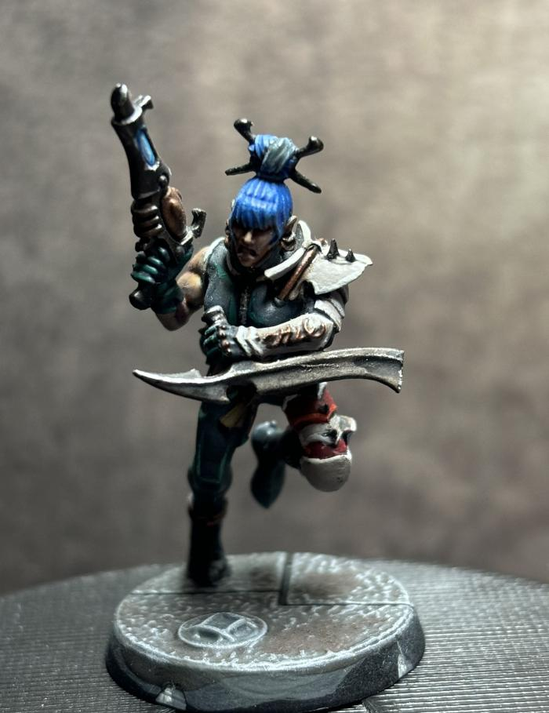
Wych (259)

Slide 32
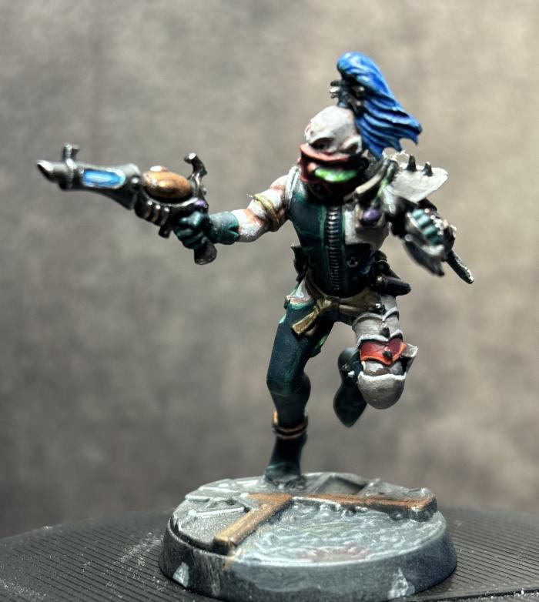
Wych (266)

Slide 33
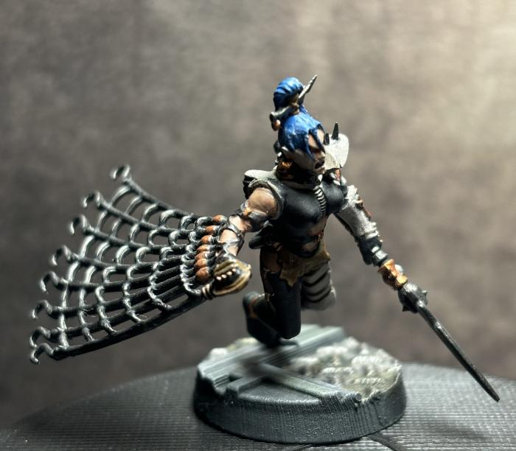
Wych (268)

Slide 34
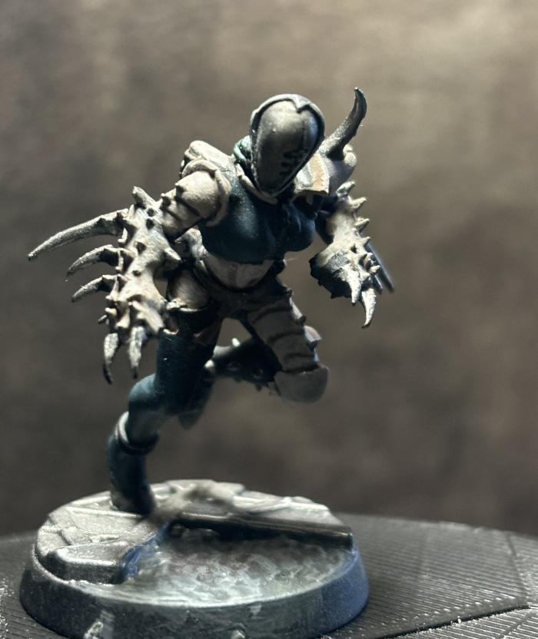
Wych (269)

Slide 35
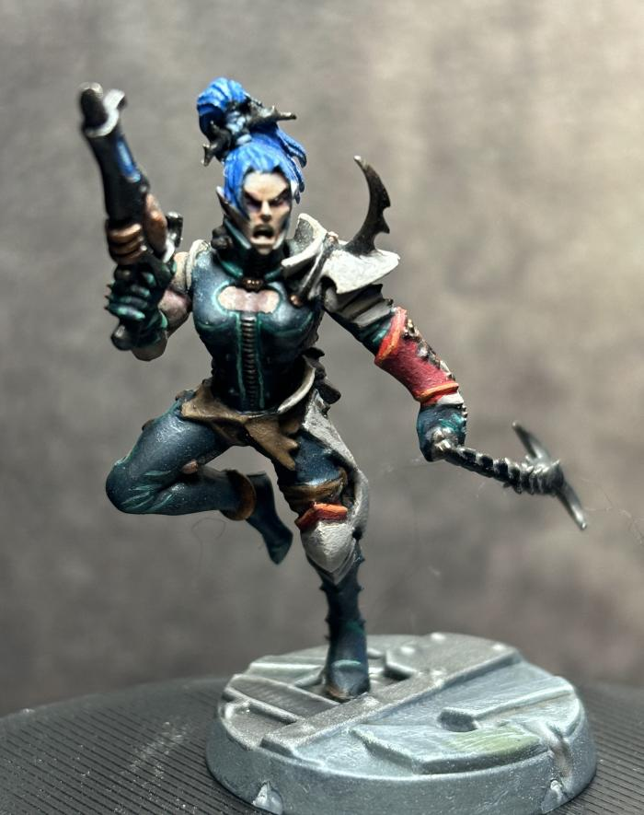
Wych (270)

Slide 36
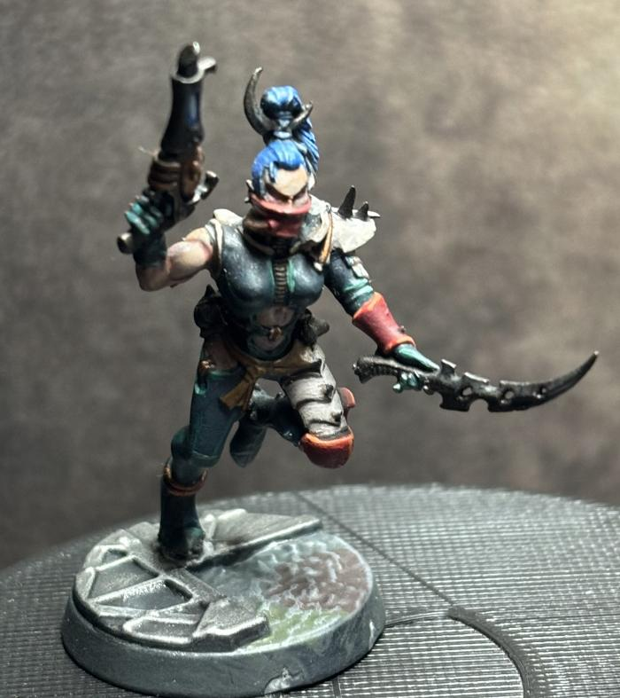
Wych (359)

Slide 37
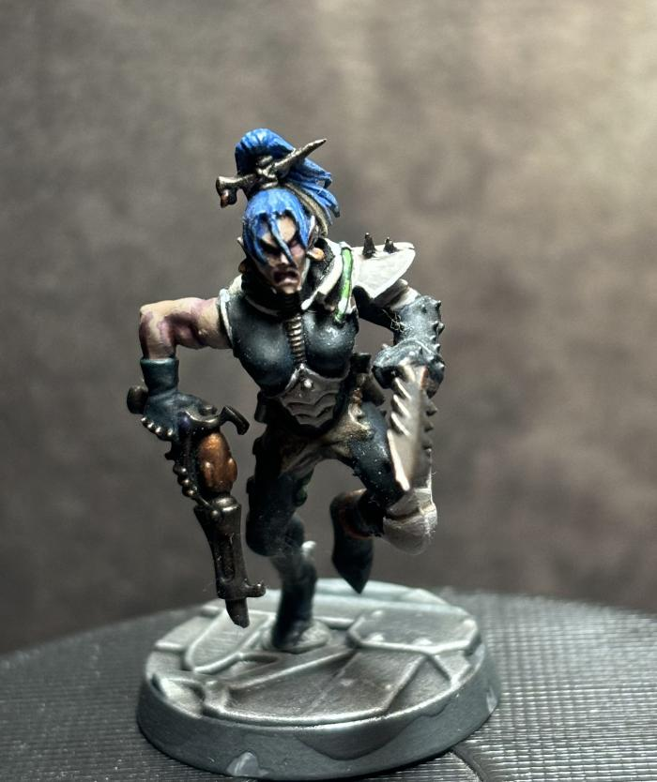
Wych (363)

Slide 38
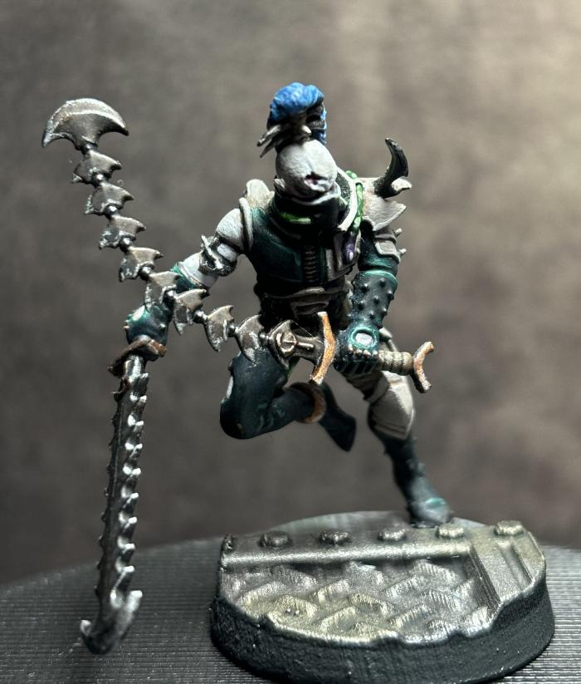
Wych (381)

Slide 39
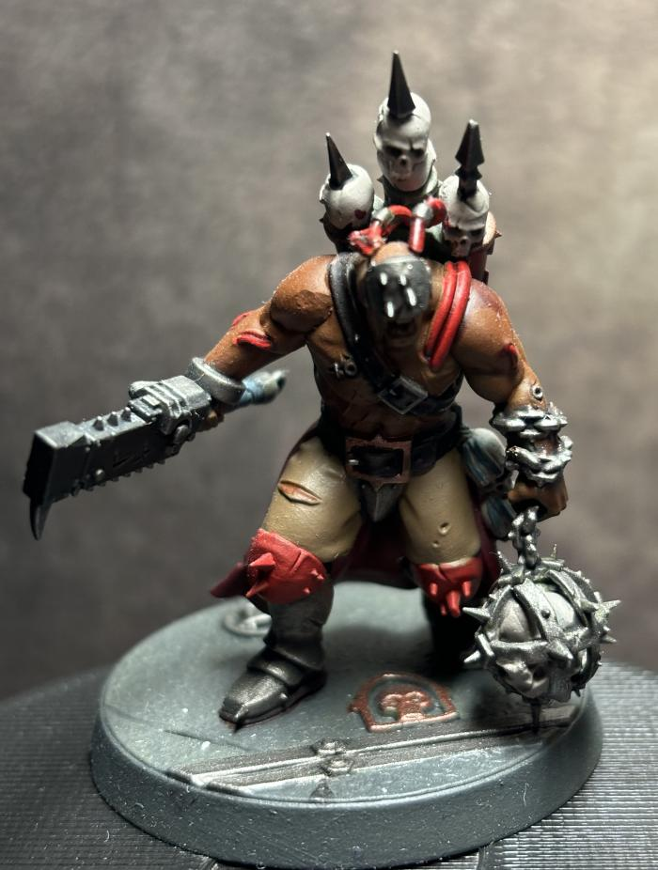
Dishonoured (392)

Slide 40
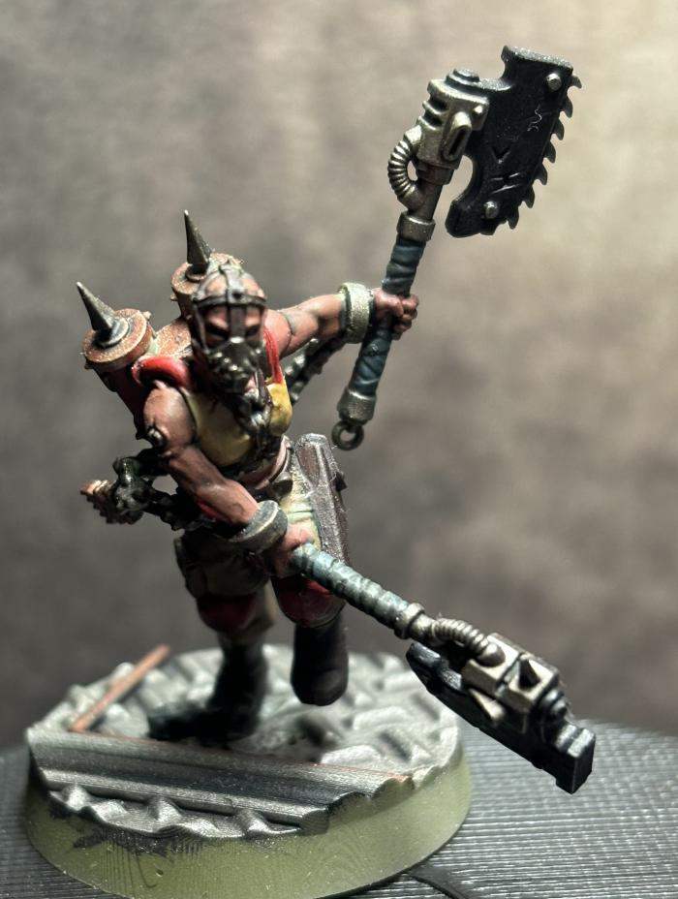
Jakhal (393)

Slide 41
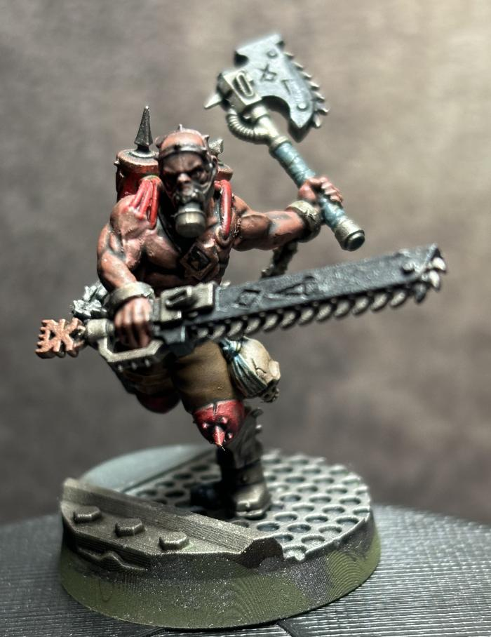
Jakhal (394)

Slide 42
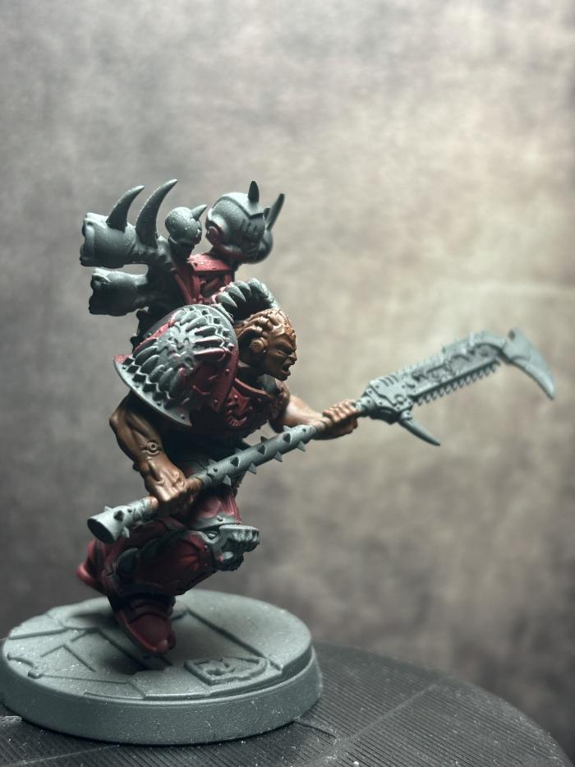
Eightbound Champion (395)

Slide 43
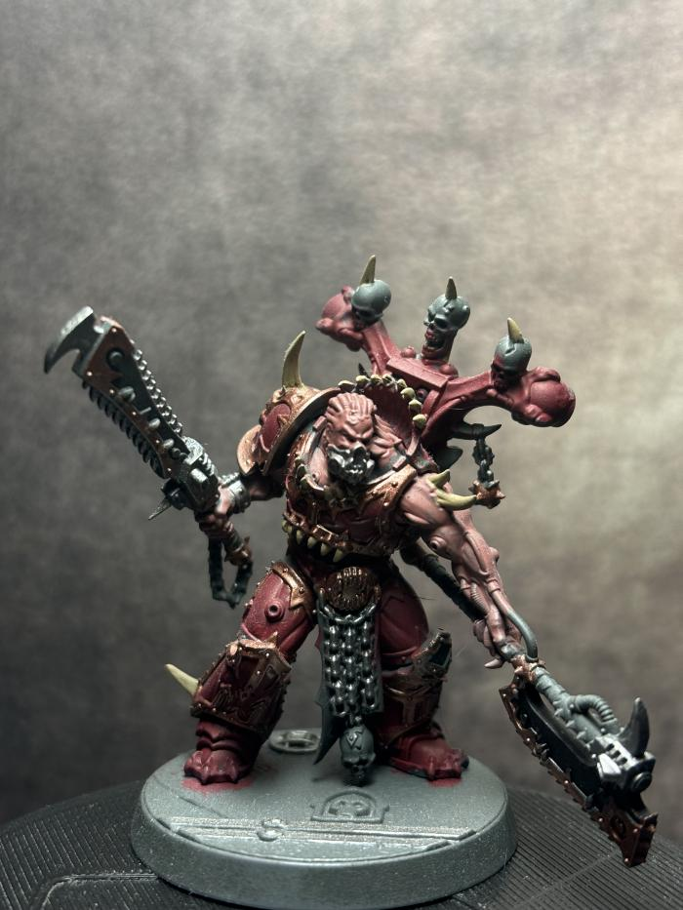
Eightbound (396)

Slide 44
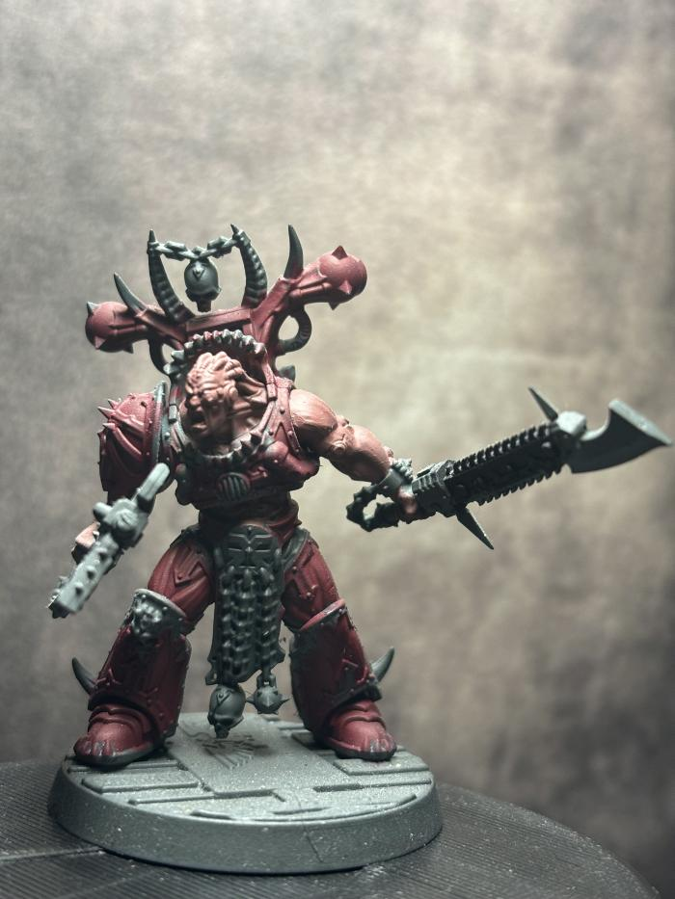
Eightbound (398)

Slide 45
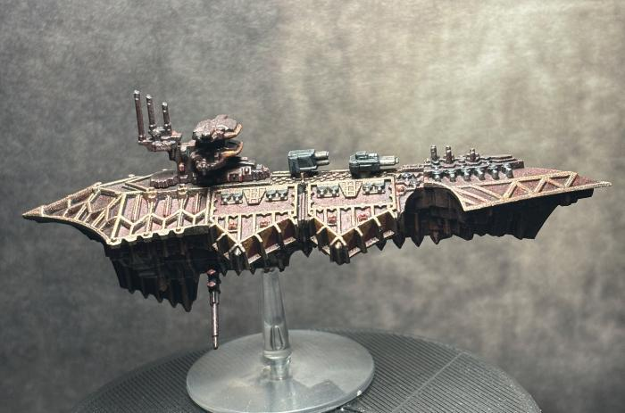
Chaos Cruiser (399)

Slide 46
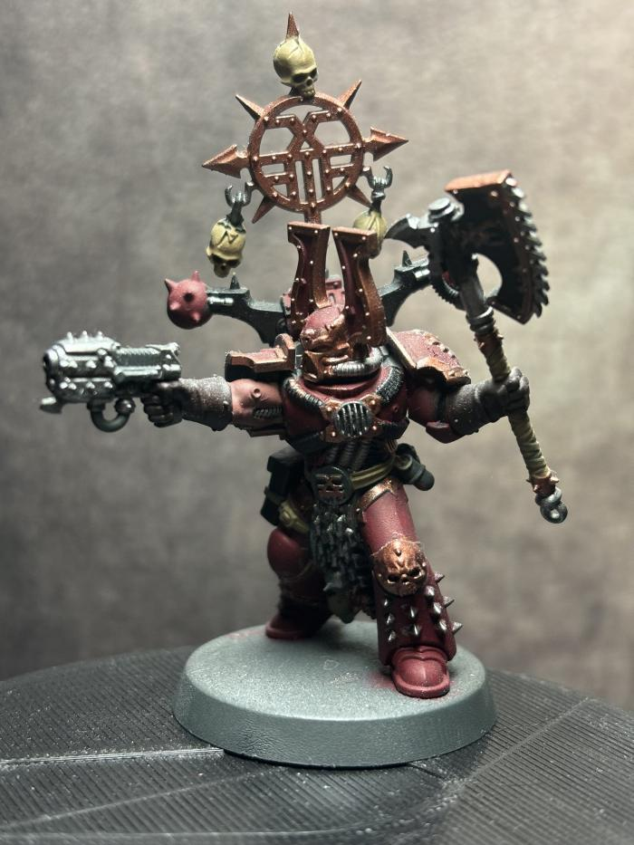
Khorne Berzerker Champion (400)

Slide 47
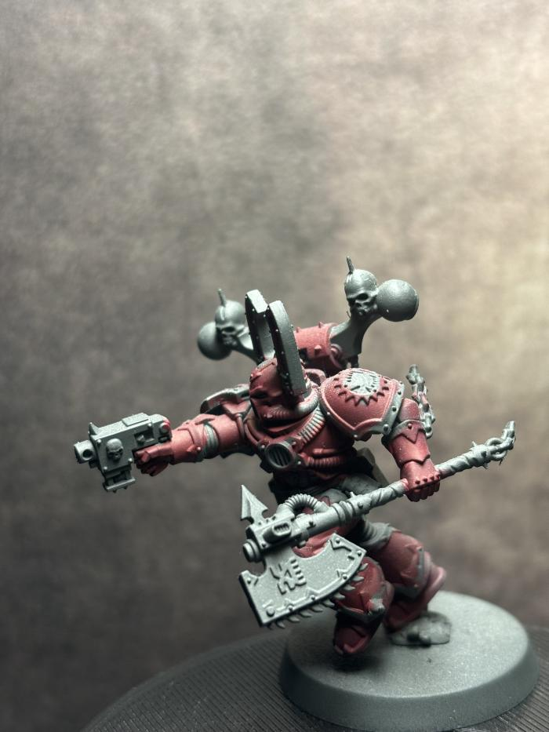
Khorne Berzerker (401)

Slide 48
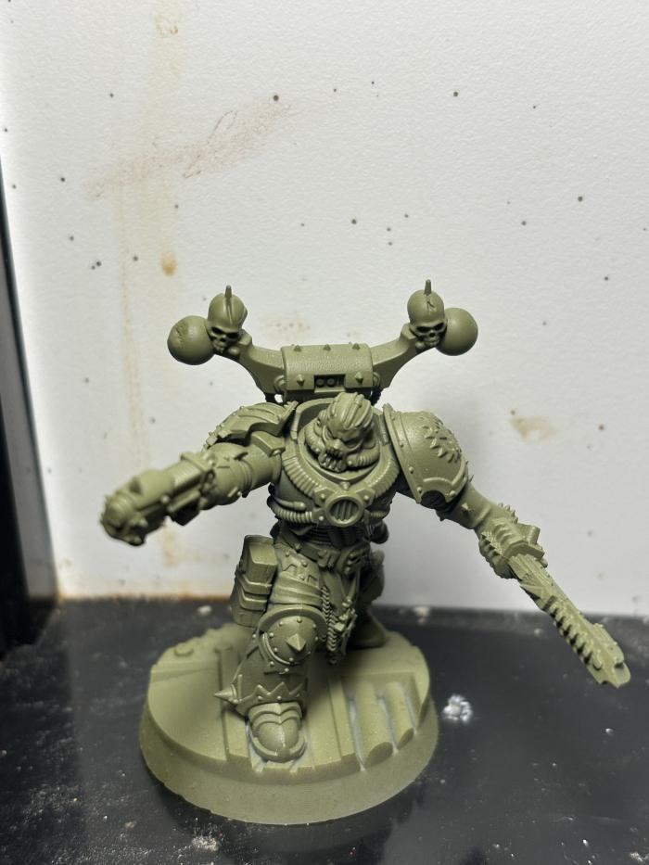
Khorne Berzerker (403)

Slide 49
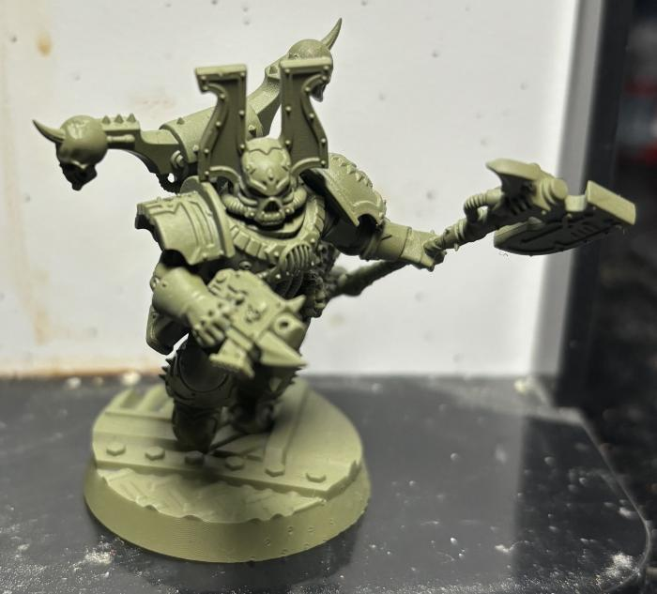
Khorne Berzerker (404)

Slide 50
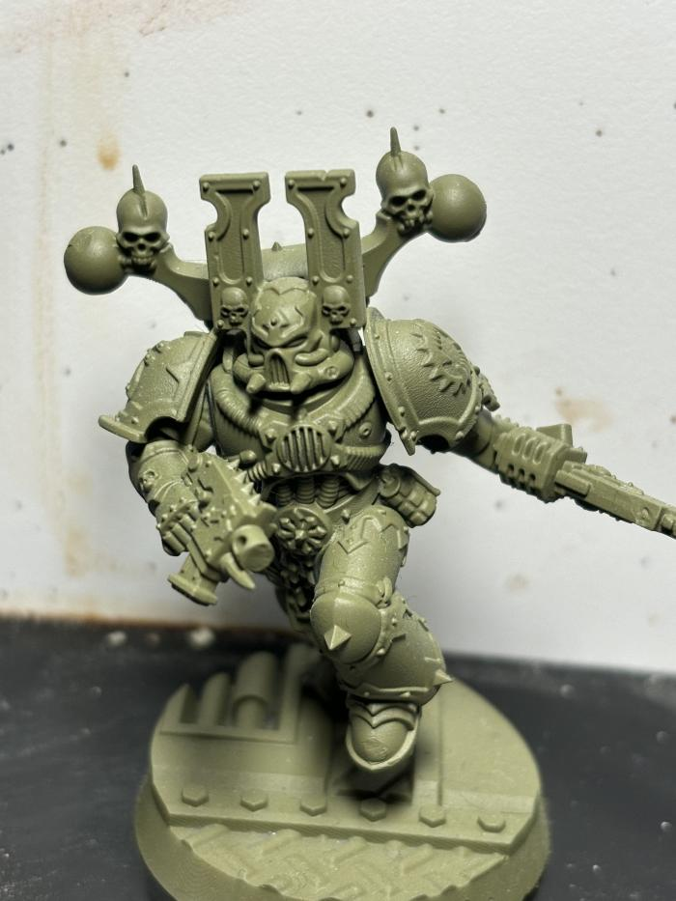
Khorne Berzerker (405)

Slide 51
Khorne Berzerker (423)

Slide 52
Khorne Berzerker Champion (424)

Slide 53
Khorne Berzerker (425)

Slide 54
Contemptor Dreadnought (426)

Slide 55
Contemptor Dreadnought (427)

Slide 56
Contemptor Dreadnought (428)

Slide 57
Contemptor Dreadnought (429)

Slide 58
Khorne Berzerker Champion (430)

Slide 59
Khorne Berzerker (431)

Slide 60
Khorne Berzerker (432)

Slide 61
Khorne Berzerker (433)

Slide 62
Malcador Tank (434)

Slide 63
Legion Sicaran (435)

Slide 64
Legion Sicaran (436)

Slide 65
Khorne Berzerker (437)

Slide 66
Jakhal (438)

Slide 67
Khorne Berzerker (439)

Slide 68
Jakhal (440)

Slide 69
Jakhal (441)

Slide 70
Jakhal Pack Leader (442)

Slide 71
Jakhal (443)

Slide 72
Jakhal (444)

Slide 73
Jakhal (445)

Slide 74
Khorne Berzerker (446)

Slide 75
Khorne Berzerker (447)

Slide 76
Khorne Berzerker (448)

Slide 77
Khorne Berzerker (449)

Slide 78
Khorne Berzerker (450)

Slide 79
Harlequin Player (679)

Slide 80
Harlequin Player (682)

Slide 81
Harlequin Player (683)

Slide 82
Harlequin Player (684)

Slide 83
Harlequin Player (685)

